Slide 1




SensorTRX
Featherweight transaction relay for
charity sensor oracles
Built by & friends - Ethereum infrastructure for social good

Slide 2

The hazardous life of an autonomous sensor oracle
Step 1: buy super expensive sensor able to support blockchain node
Step 2: create Ξth account & embed private key management in sensor
Step 3: monitor stuff & register it on the blockchain
Step 4: Hello Arctic Fox 😍
Bye bye Ξth 💸

Slide 3

SensorTRX puts sensor oracles on a diet
A featherweight, trustless transaction relay for sensors to trigger smart contracts:
No hassle: no need to create & manage Ethereum accounts for each sensor
No risk: lost or broken sensors don’t manage private keys so can’t lose Ξth
Low overhead: sensors don’t need to be directly connected to the blockchain
Decentralised: transactions don’t proxy through a centralised node
Yay! Watch
me play!
Notes:
Add use data for multiple contracts

Slide 4




How it works: sign - broadcast - relay
Sensors record data and sign it
Signed messages are broadcast publicly over the Internet
Anyone can pick them up, verify their validity off-chain & relay them to Ethereum
Relayers are rewarded once the message is accepted by the smart contract

Slide 5


Use case: integration with
Alice (www.alice.si) is a social impact network built on Ethereum that helps identify provably effective charity projects
Donations on Alice are conditional on results: a charity only
receives money if it proves it has achieved its goals
Until now, claims made by charities on Alice had to be verified
by a human validator
SensorTRX will now allow claims to be auto-validated by sensors
Example: a charity project reducing air pollution
can have its claims validated by air quality sensors

Slide 6






High level infrastructure
SensorTRX
smart contracts
Off-chain verification
+ trx submission
Relayer bounty
Elliptical curve digital signature
SENSORS
Read from public messaging (d)apps
RELAYERS

Slide 7

Smart contract infrastructure
SENSOR MGMT CONTRACT
Whitelist sensors
(De)activate sensors
Credits Ξth for gas & relay bounties
PROJECT CONTRACT
AUTHENTICATOR
CONTRACT
Manages
sensors
VERIFIER CONTRACT
PROJECT ADMIN
Admin gatekeeper
Main interface
Verification logic
Signature verification
Query response
Sensor whitelisted?
CHARITY CLAIMS REGISTRY CONTRACT
Data query for
off-chain verif.
NO
Add claim (clean air!)
Validate claim
SENSORS
Relayer submits sensor data/msg
YES
Data validates a claim?
Broadcast
signed data
NO
RELAYER
YES
Contract pays
relay bounty
Relayer decides to
relay to blockchain
Clever relayer
decides not to relay

Slide 8
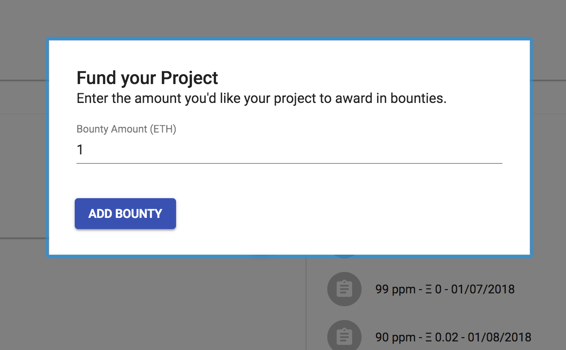
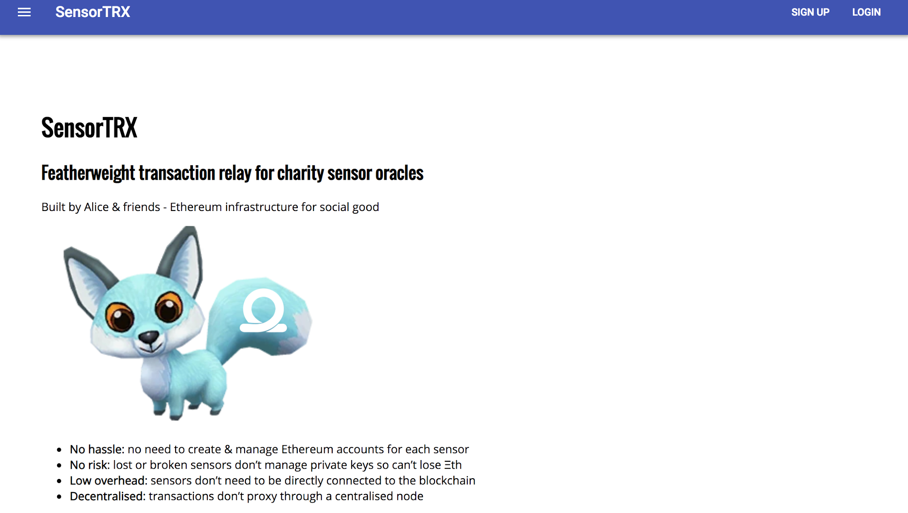
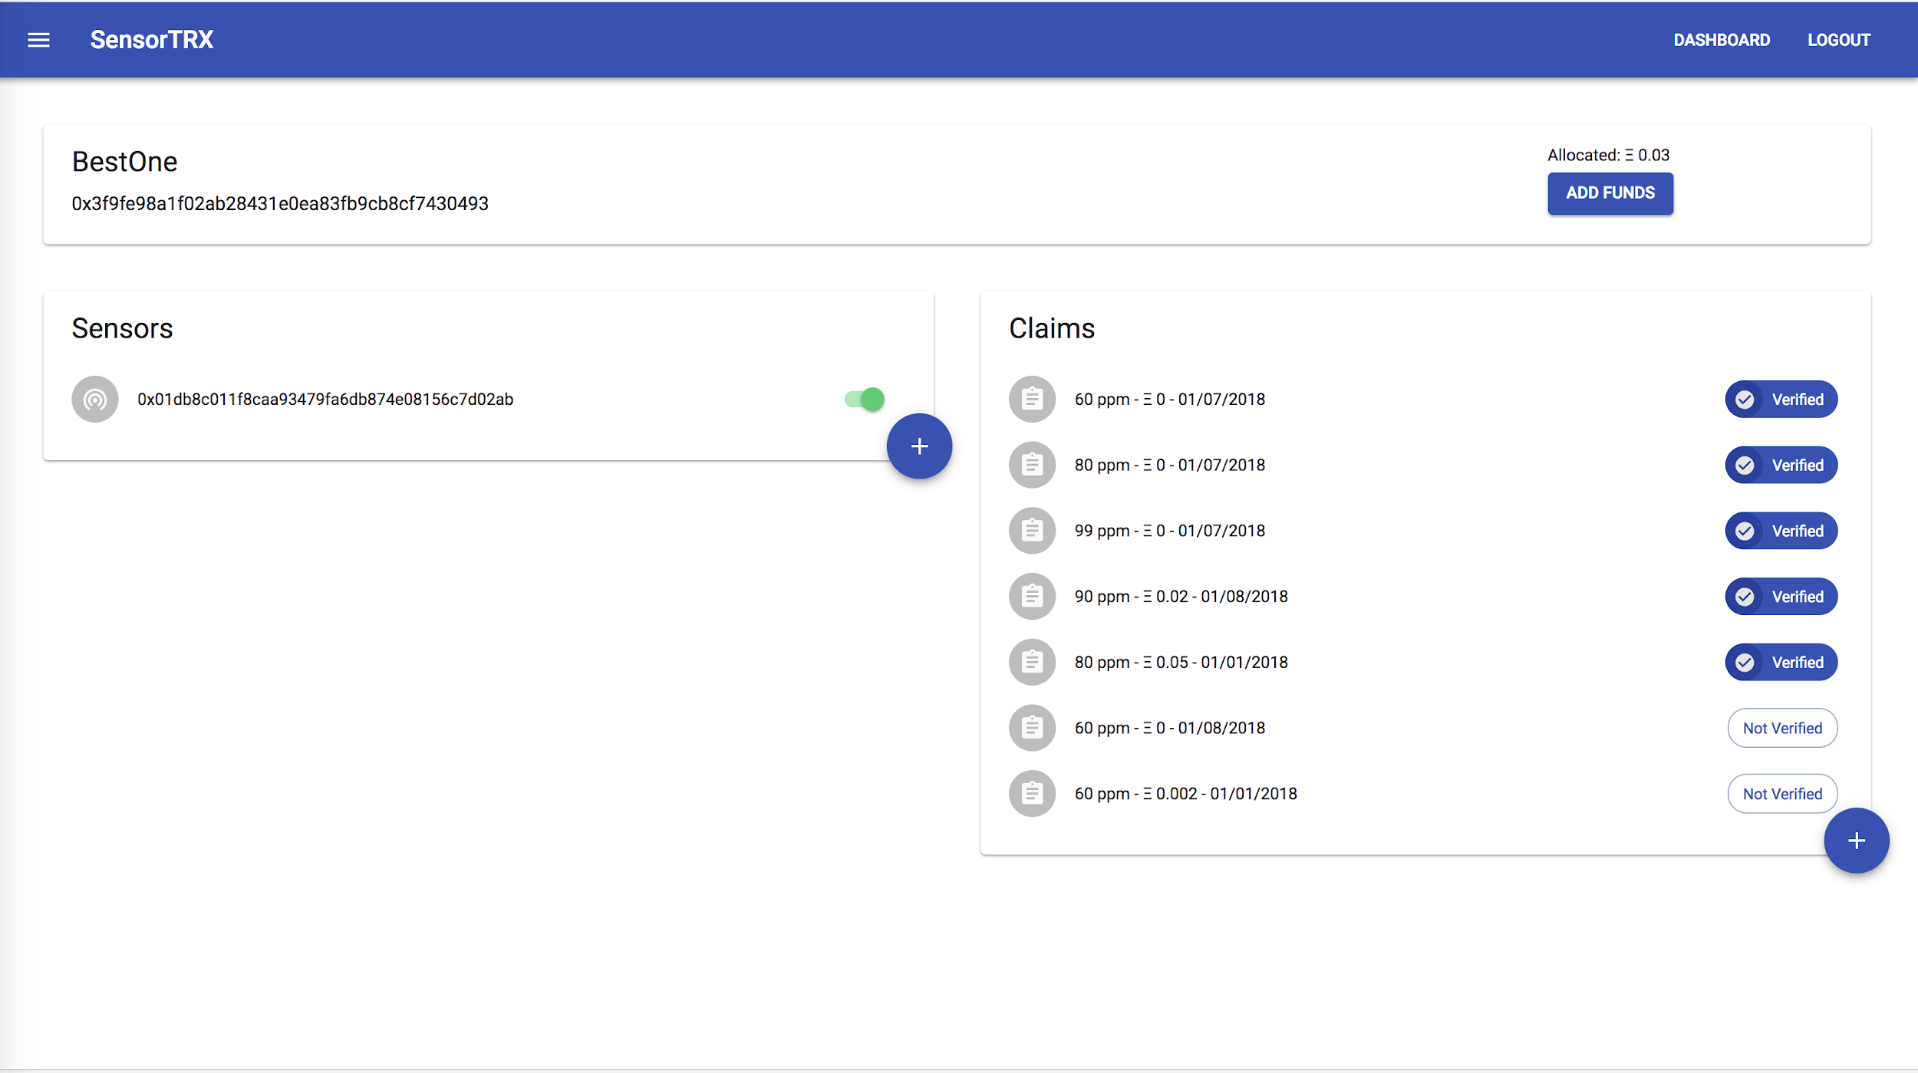
Check out our demo

Slide 9




Meet the team
Alex
Will
Kuba
Raph
Trxy
Trxy credit: Paradise Bay

Slide 10

Trxy the arctic fox thanks you!
Much charitable
Very sensor!
Yip yip!
Play my gif!

